Slide 1
TensorFlow III

Slide 2
Housekeeping
Office hours moved to Monday 12-3 for the next week
GPUs should be running 4-8 for the next week
  When I forget (it has to be started manually so it’s when not if) or if you need a time outside or that, email me
    This also applies to homework clarity issues
    Is there a reason people have stopped emailing me?
You have to use drop out layers when appropriate in the CNNs for full homework credit
I’m going to try to issue a bunch of clarifications today
If you’re one of the ~2 people who have been complaining, you can use LSTMs for the current homework as appropriate with prior approval of Matt
Matt will be releasing incredibly detailed guidelines on submitting code
  Half the class has been submitting it wrong, so clearly they weren’t clear enough, so we won’t penalize anything reasonable before now
  Starting with the next homework, we will, because it really does make grading incredibly hard at this scale
If you have questions about “how do I use this feature correctly” as I know many of you have (or should have based on homeworks), please ask me
You’ll get homework 1 back next week

Slide 3
The numbers in the SVM
Lists output after training
Many of you had them be 0s
This was because you didn’t train them, explanation for this on ELMS awhile ago
Numbers in the list represent the model in the SVM, if they’re all 0s somethings wrong

Slide 4
Preprocessing
Training neural nets on information they don’t need is bad
  This includes colored image, large images, etc
  You have to square images
  Certain image techniques like increasing contrast can help a lot
  If you can figure out how many convolution layers you need, try to use that number and not more. Additional layers are often useless or counterproductive
  You can’t just use numpy for image transforms
    OpenCV
Normally you create a preprocessing script, save the outputs, and call them for training
  You can’t do that when you turn them in though, for what should be obvious reasons
Hdf5
keras.utils.to_categorical (for numpy arrays)

Slide 5
Loss functions and accuracy metrics
https://keras.io/metrics/
https://keras.io/losses/

Slide 6
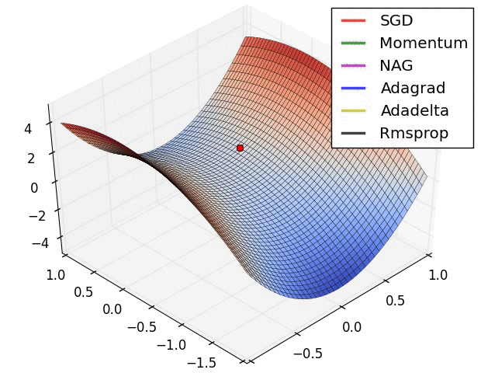
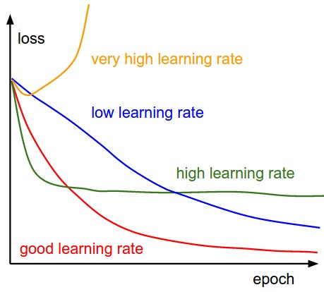
Optimization
Adam et. al.
Dropout
Regularization
Learning rate
These will change accuracy during training
Keras has good defaults
Try to scale input values to be between less than .001 and 1

Slide 7
Formatting image arrays for 2D Conv Layers in TensorFlow (including keras as a backend)
<npArray>.shape=(<number of items>,<y>,<x>,<color>)
Need 1 layer even for greyscale images

Slide 8
Epoch/batch size

Slide 9
Visualizations
MatPlotLib
  Seaborn
Plot accuracy over time
TensorBoard

Slide 10
Validate EVERYTHING
It’s incredibly easy to train your neural net on the wrong thing, we’ve all done it
If you can pull data points and explain why your model can’t learn on them you know what’s happening
Skim a print of neural net bias and weight values

Slide 11
Optimizing hyperparameters
Hyperparameters are the params that establish the structure of the model… NN architecture details (number of layers, number of nodes, etc); choices of loss function, optimizer, and metric; etc.
Don’t hold RNG seed constant unless you’re explicitly working on improving or reproducing a specific output.

Slide 12
Facebook, China, and why ethics and regulations are so important in AI

Slide 13
The five horsemen of machine learning
Super intelligent AI taking over the world (or similar)
AI accidentally killing humans because humans gave it bad directions
Humans using ML to kill humans
Humans using ML to manipulate humans in mass
AI bias

Slide 14
Facebook
You know those Facebook apps that used to be popular? Like Farmville and the spammy quizzes?
Aleksandr Kogan, professor at the University of Cambridge who does data based psychology research from social media, created a psych quiz for this that required users to send over all your Facebook likes (and other information), ~270k people took it
He found a vulnerability that let him get this information for all the friends of the user without consent
  This information can predict a person's decisions better than their spouse or best friends can
He then either sold the data to Cambridge Analytica or sold the app to Cambridge Analytica depending on whose lawyer you ask
This was two years ago, Facebook did not disclose the breach or do anything to stop Cambridge Analytica from using that data to target ads

Slide 15
Facebook
Once this information and a series of other scandals surfaced Facebook management responded in what most business management textbooks consider the worst way imaginable, resulting in:
Pissing everyone off so much that they may be indicted in the EU and/or UK
Personally being sued by investors for fraud, breach of contract, etc. by investors
Many major companies have deleted their Facebook pages and stopped advertising
Facebook has lost over $100 billion in market cap
Many of their cofounders or cofounders of their major acquisitions have called for people to delete Facebook

Slide 16

International political consulting and services firm headquartered in the UK
Largely did data based advertising
  There’s also a lot of circumstantial evidence they entrapped competing politicians with prostitutes, bribed officials, and offered a variety of comparable services
They were cofounded by major far right Brexit supporters in the UK and Steve Bannon (one of the more prominent Neo Nazis who worked for Trumps campaign)
Cambridge Analytica contributed to the campaigns of Ted Cruz, Donald Trump and Brexit

Slide 17
https://github.com/aymericdamien/TensorFlow-Examples/blob/master/notebooks/3_NeuralNetworks/recurrent_network.ipynb
Correct logits
Why I show imperfect code

